Slide 1
PRASANNAAKSHMI M
Final Project
3/21/2024 Annual Review

Slide 2
SENTIMENT ANALYSIS BASED ON REVIEWS
3/21/2024 Annual Review

Slide 3


AGENDA
Problem Statement:
Abstract text summarization with deep learning tackles sentiment analysis challenges in large datasets.Project
Overview:
Using LSTM for abstract text summarization, our project aims for concise sentiment analysis.
End Users:
Our solution offers concise, context-aware summaries for comprehensive insights.
Our Solution:
Leveraging LSTM networks, we capture nuanced sentiments in abstract texts efficiently.
The "Wow" in Our Solution:
Integrating LSTM networks and optimization techniques sets our solution apart for accurate sentiment analysis.
Modeling:
Optimizing LSTM architecture enhances sentiment analysis accuracy.
Results:
Our solution effectively summarizes abstract texts and captures sentiment nuances.
Conclusion:
Our project advances sentiment analysis, providing concise insights from vast textual data through deep learning.
3/21/2024 Annual Review

Slide 4

PROBLEM STATEMENT
Sentiment analysis plays a pivotal role in extracting insights from voluminous textual data, particularly in the realm of customer reviews, social media posts, and surveys.
However, traditional methods often struggle to capture the nuanced sentiments expressed in these texts accurately.
Therefore, there's a growing need for advanced techniques that can efficiently summarize and analyze sentiment from abstract texts using deep learning concepts.
3/21/2024 Annual Review

Slide 5

PROJECT OVERVIEW
Our project utilizes LSTM networks for abstract text summarization in sentiment analysis.
The goal is to distill complex textual data into concise yet comprehensive summaries, preserving sentiment nuances.
By integrating advanced deep learning techniques with sentiment analysis algorithms, we aim to revolutionize the field, particularly in handling abstract or nuanced textual content.
Ultimately, our system aims to offer a streamlined solution for extracting meaningful insights, empowering users to make informed decisions confidently.
3/21/2024 Annual Review

Slide 6

WHO ARE THE END USERS?
Our solution caters to diverse end users, including:
Business Analysts: Gain actionable insights from customer reviews and social media sentiments.
Marketing Professionals: Gauge customer sentiment to refine strategies and messaging.
Customer Service Teams: Analyze feedback to enhance satisfaction and service quality.
Product Managers: Monitor product reviews for feature requests and issues.
Market Researchers: Identify trends and consumer opinions for market analysis.
3/21/2024 Annual Review

Slide 7
YOUR SOLUTION AND ITS VALUE PROPOSITION
Our solution:
Accurate Sentiment Capture: LSTM networks effectively capture nuanced sentiments in abstract texts.
Contextually-Aware Summaries: Our system crafts concise yet comprehensive summaries while preserving context.
Efficiency and Reliability: Integrating advanced techniques ensures efficient and reliable sentiment analysis.
Value Proposition:
Unparalleled Accuracy: Captures sentiment nuances in complex texts accurately.
Enhanced Decision-Making: Contextually-aware summaries empower confident decisions.
Streamlined Workflow: Efficient and reliable, our solution saves time and resources.
3/21/2024 Annual Review

Slide 8

THE WOW IN YOUR SOLUTION
Integration of Advanced Techniques: By seamlessly blending LSTM networks with optimization strategies, our solution achieves unprecedented accuracy in capturing sentiment nuances.
Contextual Preservation: Our system's ability to generate concise summaries while retaining contextual richness sets it apart, ensuring a deeper understanding of the underlying sentiments.
Efficiency and Scalability: With its efficient and scalable architecture, our solution caters to the demands of large-scale sentiment analysis tasks, delivering reliable results with minimal computational overhead.
3/21/2024 Annual Review

Slide 9
MODELLING
Neural Network Architecture: Designed for abstract text summarization, our model features optimized LSTM layers.
Input Transformation: Utilizes advanced techniques to preprocess and encode textual data effectively.
Optimization Techniques: Integrates gradient descent algorithms and learning rate schedules for parameter fine-tuning.
Hyperparameter Tuning: Fine-tunes parameters to optimize model performance and generalization.
Evaluation and Validation: Employs comprehensive metrics to assess model effectiveness accurately.
3/21/2024 Annual Review

Slide 10
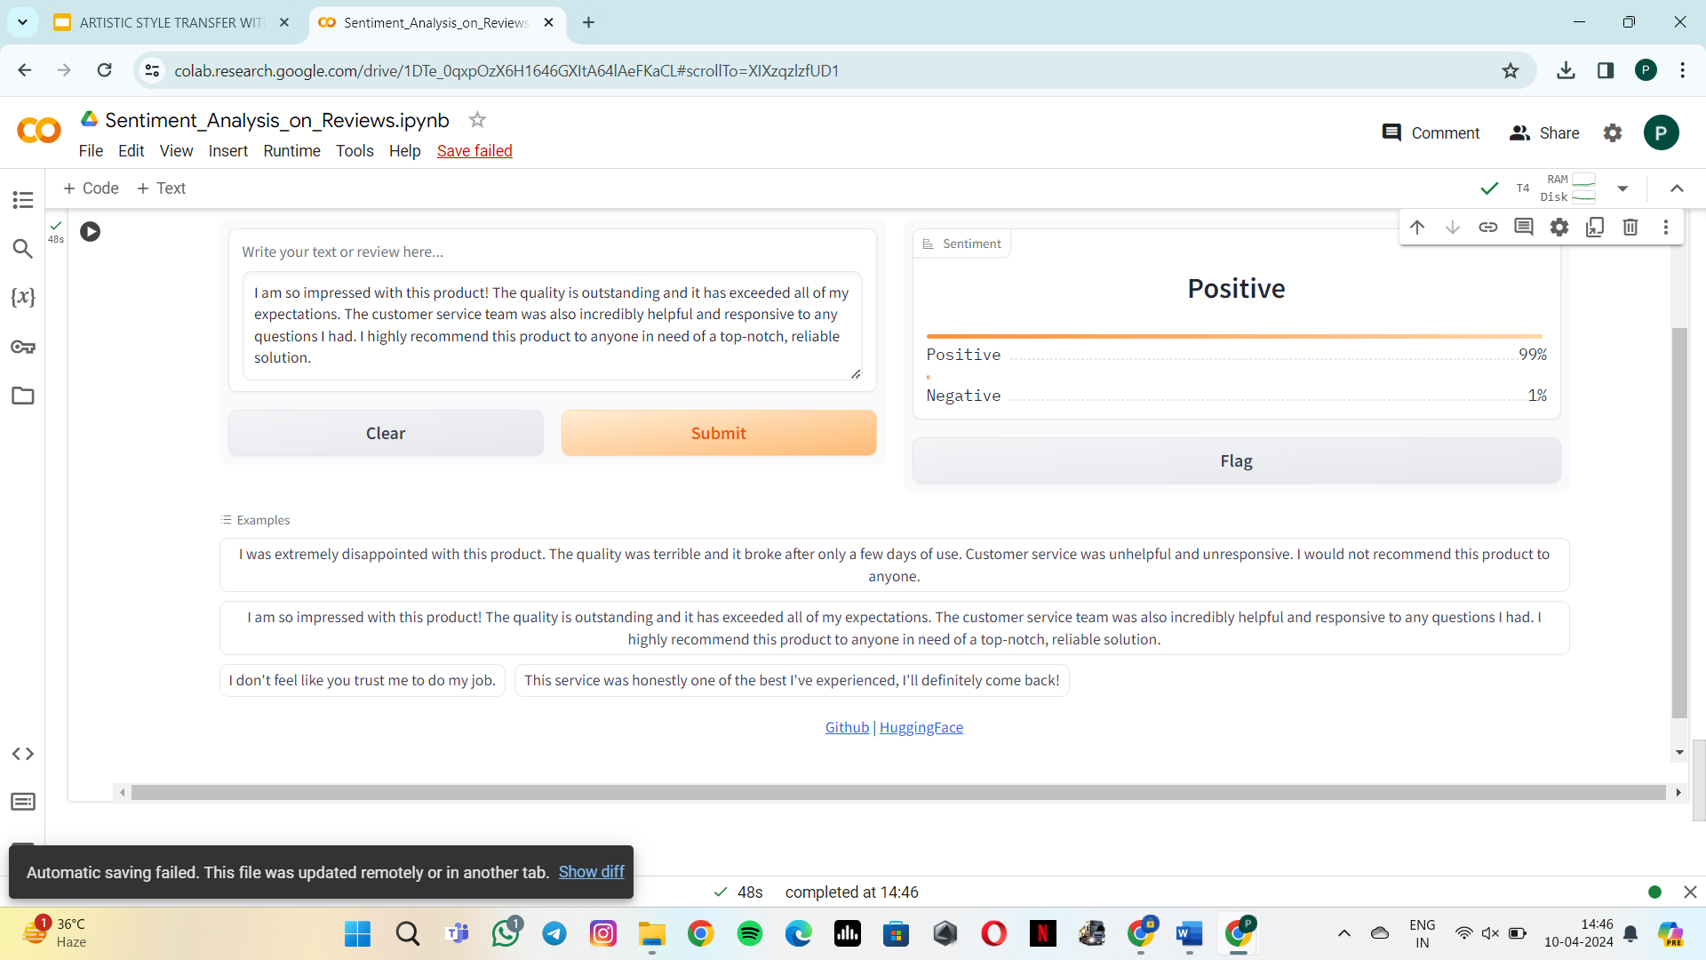
RESULTS

